Slide 1
6.1 - Automated systems
Describe how sensors, microprocessors and actuators can be used in collaboration to create automated systems
Describe the advantages and disadvantages of an automated system used for a given scenario
Including scenarios from:
– industry
– transport
– agriculture
– weather – gaming – lighting – science

Slide 2
Today
Describe how sensors, microprocessors and actuators can be used in collaboration to create automated systems
Describe the advantages and disadvantages of an automated system used for a given scenario
Including scenarios from:
– industry
– transport
– agriculture
– weather – gaming – lighting – science
Understand: What are sensors
Able: Find scenarios for sensors
Answer: What does an actuator do?

Slide 3
Easy Lesson
Nice and easy lesson.
Just a few words:
Microprocessor
Actuator
Sensor
Monitor System
Control System

Slide 4
Key Words
Microprocessor
Same as a CPU, same as a processor. Just a chip that can process data
Actuator
A device that when you give it electricity, it moves, which then moves something else. (more on this on the next slide)

Slide 5
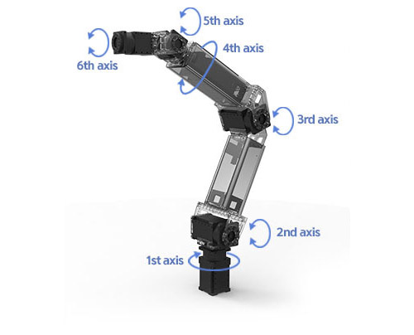
Actuators
Sometimes an output does not have to make something (soft copy or hard copy) sometimes an output can just be making something else move.
If a signal is given to a device and then that device helps something else move then the device that first got a signal is called an actuator
Actuator = A device that gets a signal. When it gets a signal it moves something else
Actuators can:
Open / Close
Push / Pull
Rotate
Used in:
Robotic arms
Pumps
Hard drives

Slide 6
Key Words (part 2)
Sensor
Input device
Records data about the physical environment around it (Cambridge)
It takes that data and sends it to a computer
The computer will then do something
A sensor can do it automatically, no need for a human
Many different types of sensor:
Light Sensors
Infrared sensors
Temperature sensors
Motion Sensors and accelerometers
Magnetic field sensors
Gas
Pressure
Moisture
Humidity
pH

Slide 7
Key Words (part 3)
ADC = Analogue to Digital Converter
Takes a physical (analogue reading) and converts it to a digital signal so a computer can understand it
DAC = Digital to Analogue Converter
Takes a digital signal and converts it into an analogue signal. Usually requires an actuator

Slide 8
Key Words (part 4)
Monitor System
Sensor sends data to a computer via an ADC
If the value of the data is too high or low then something happens. Maybe an alarm sounds or a display is given. But then you as a Human have to do something.
Control System
Sensor sends data to a computer via an ADC
If the value is too high or low then the computer can send signals to devices to turn off/on or to open/close. Usually these devices are connected to actuators. If they are connected to an actuator then a DAC (Digital to Analogue) converter is used. There is no need for a human

Slide 9
Automated Systems
So when you have a sensor to record the physical environment, it then uses an ADC to convert this reading.
This digital signal is then understood by the microprocessor.
The microprocessor then may need to do something
Then it sends a signal to do something
This signal is converted by a DAC and an actuator moves somethings
The whole process is automatic
This is called a Control System but can also be called an Automated System

Slide 10
Task
Three examples of where its used
What type of sensors does it use
At least 2 advantages
At least 2 disadvantages
Could it be done without sensors? / How could it be done without sensors?
Pick 2 numbers between 1 and 7
– industry
– transport
– agriculture
– weather
– gaming
– lighting
– science
Task:
Find examples of automated systems in the industry you have picked
Create something beautiful to show your findings

Slide 11
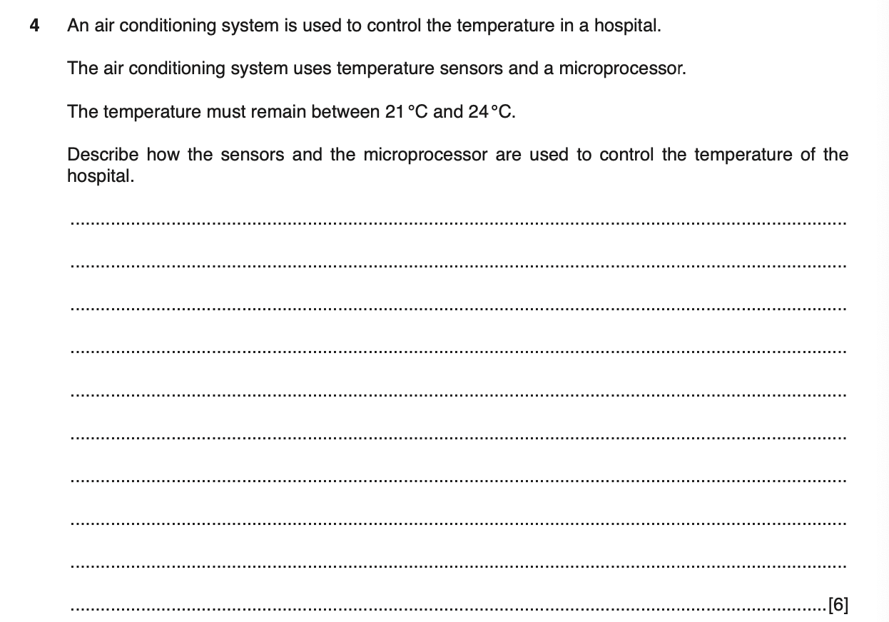
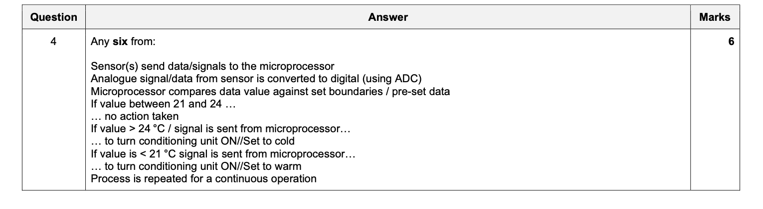

Slide 12
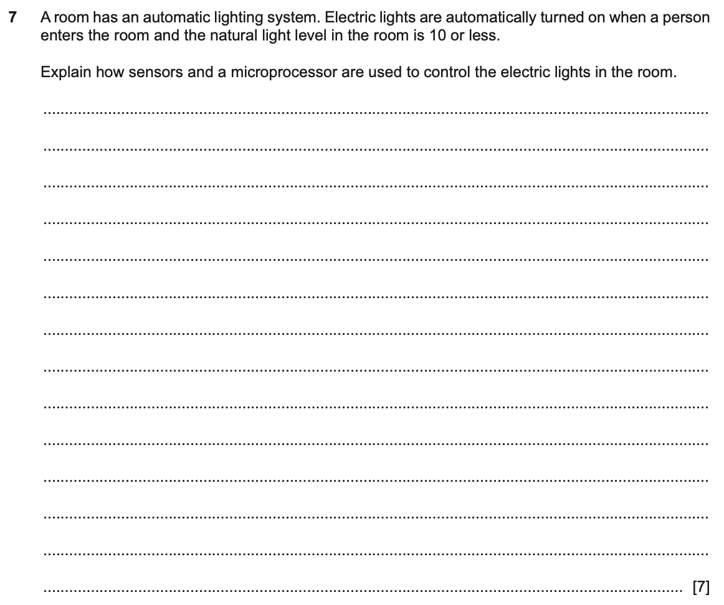
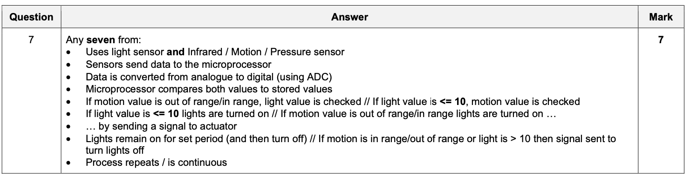

Slide 13
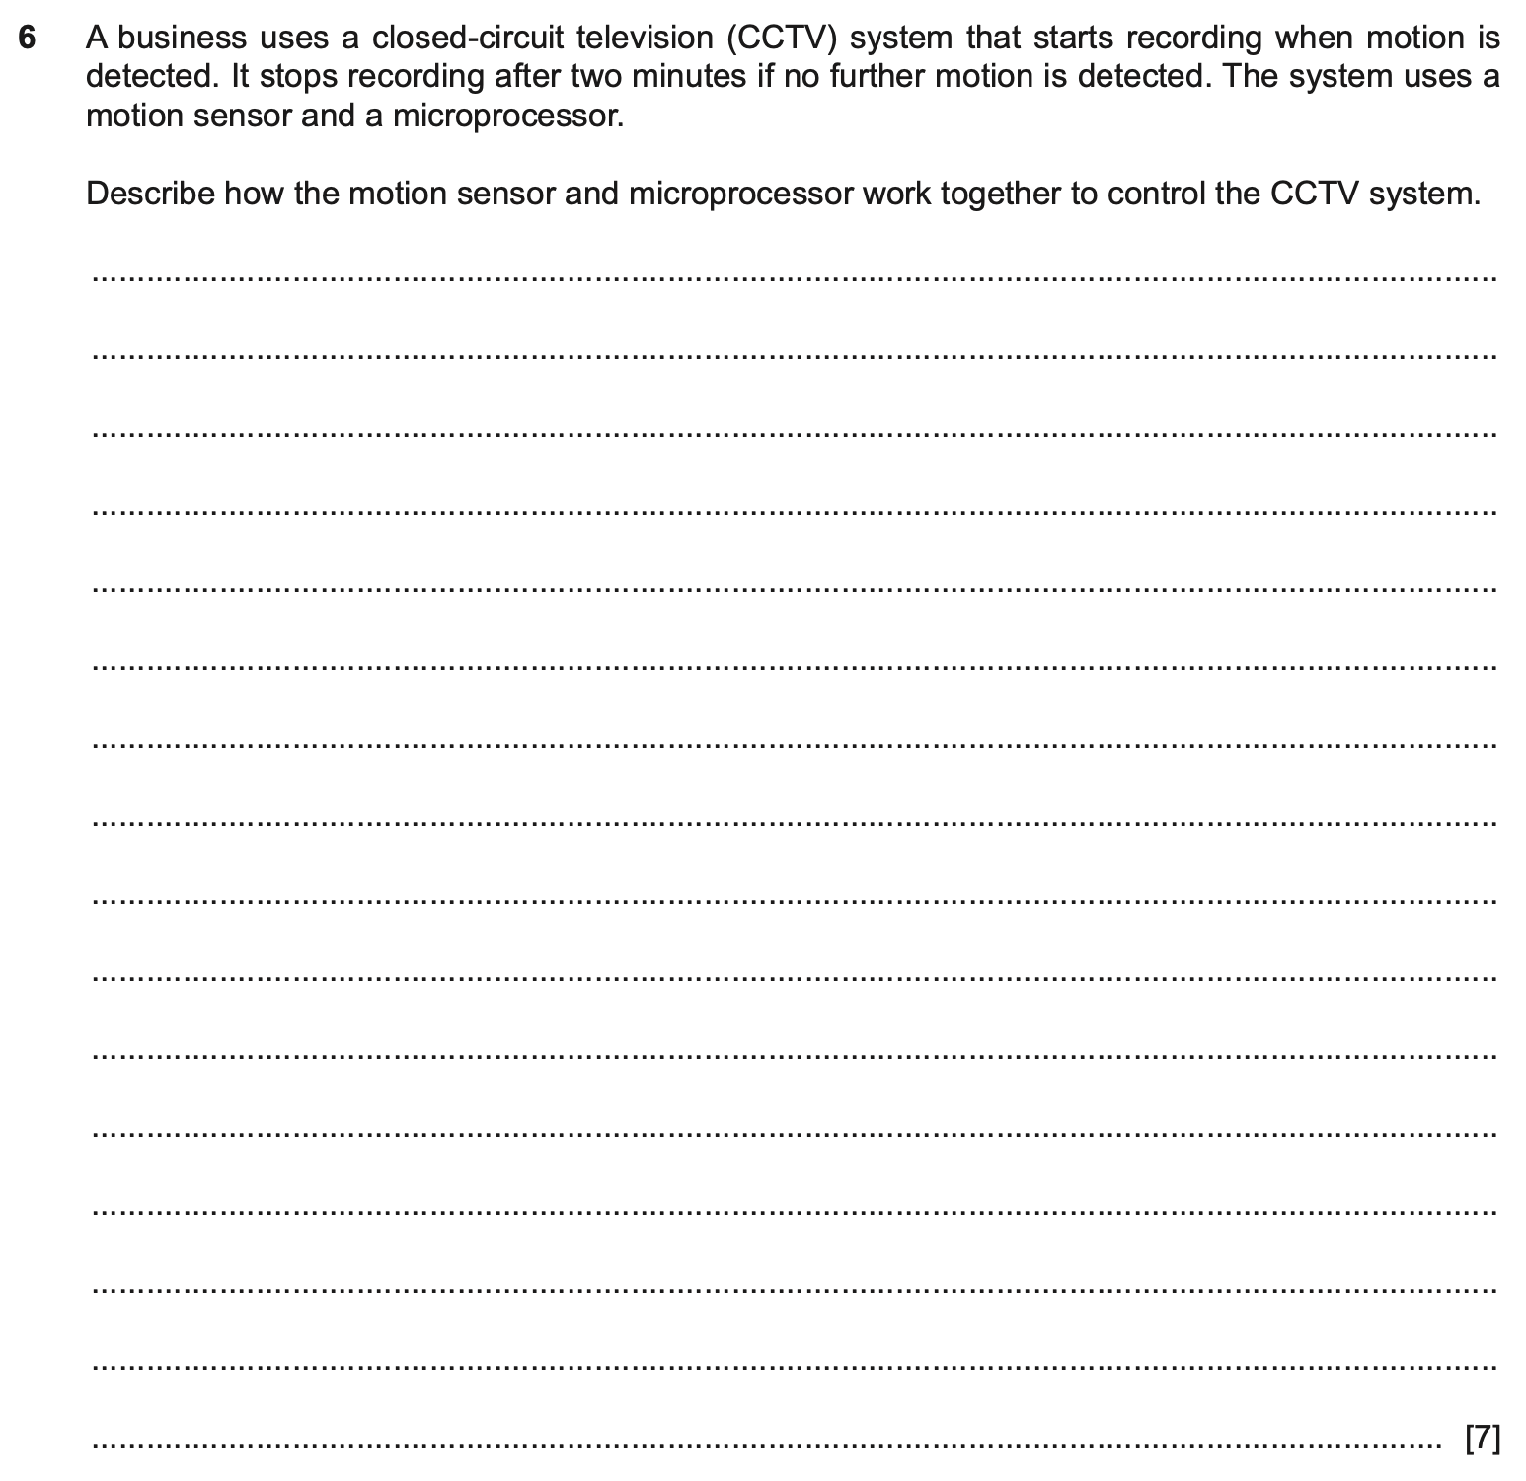
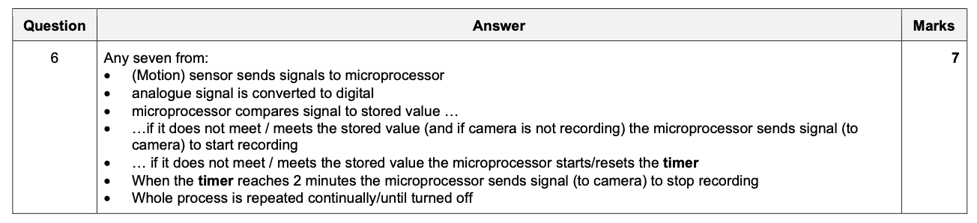

Slide 14
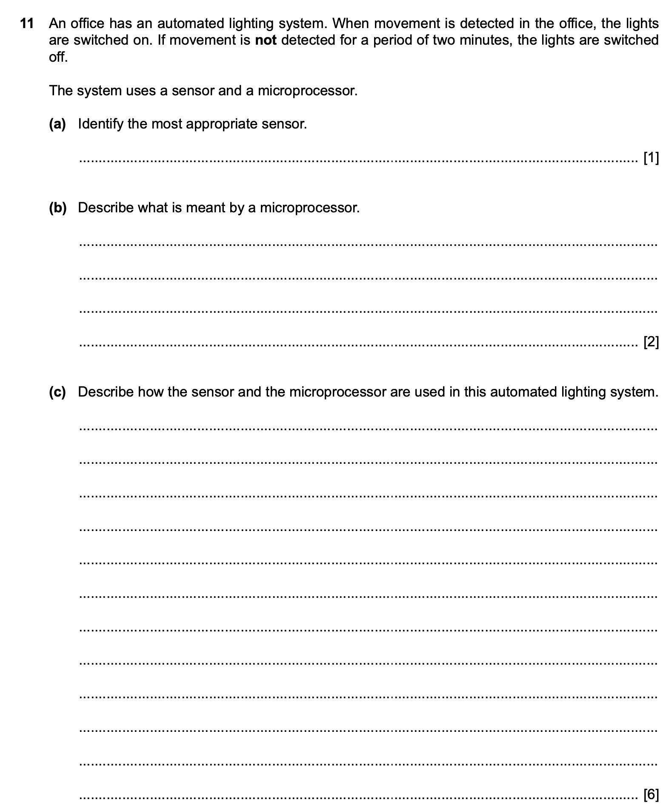
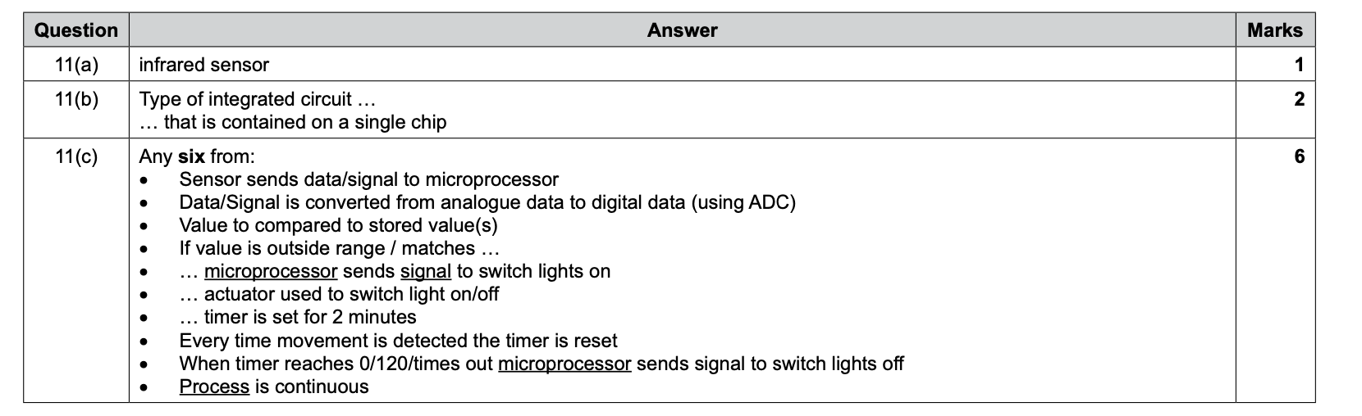

Slide 15
Sensors
What is it?
Input device
Records data about the physical environment around it (Cambridge)
It takes that data and sends it to a computer
The computer will then do something
A sensor can do it automatically, no need for a human

Slide 16
Light sensors
Looks at how much ambient light there is
Ambient Light = How bright or dark it is at that moment
Your phone has a light sensor
Automatic street light
Security systems
QR code scanners
Barcode scanners

Slide 17
Infrared Sensors
Infrared sensors is a temperature sensor
It detects infrared radiation from an object or person.
Where:
Your TV has an infrared sensor so it can receive signals from your remote control
Infrared cameras have infrared sensors so it can see body temperature.
You can use infrared camera when tracking criminals or hunting animals
Infrared sensors are also used in F1 racing to measure the heat of tyres
Astronomy photos also use infrared sensors and cameras

Slide 18


Slide 19
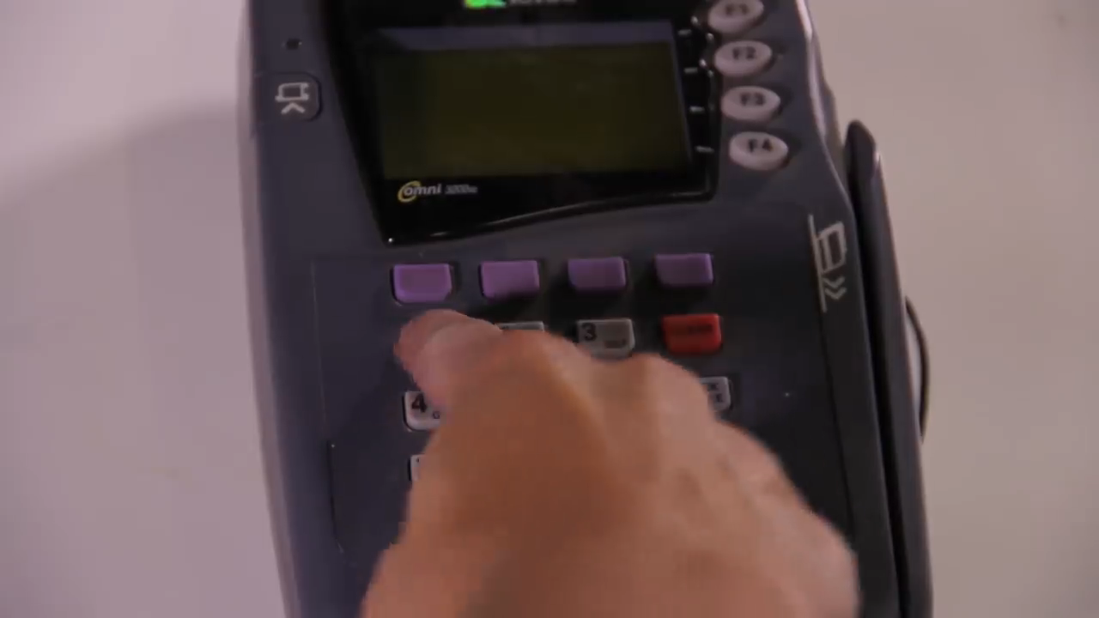

Slide 20
Temperature sensors
There are more ‘normal’ temperature sensors than infrared sensors
There are two main types:
Contact Temperature Sensors
Non-contact temperature sensors
Contact temperature sensors need to actually touch / make contact with the object they are are measuring
Non-contact temperature sensors measure the energy that is radiated from an object.

Slide 21
Temperature sensors
Fridge (to keep it cold)
Oven (to keep it hot)
Climate control
If you use a temperature sensor to make sure your environment is at the the temperature you want it to be then you are probably using a thermostat.
Thermostat = Device that keeps the temperature at a constant level

Slide 22
Thermostat
This has two pieces of metal and a temperature sensor.
You set whatever you want the temperature to be.
The temperature sensor checks the temperature of the area (the ambient temperature)
If the temperature needs to become hotter then these two pieces of metal join together, this makes a circuit and electricity can pass through warming it up.
If the temperature needs to be colder then the two pieces of metal separate and this means no circuit and no electricity and no heat.
You’ll use a thermostat in your house to control the heat

Slide 23
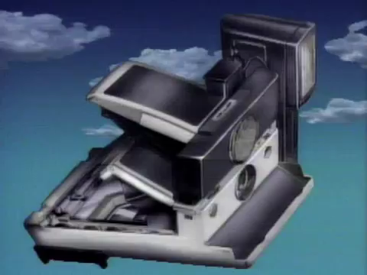

Slide 24
Motion sensors
Guess what this does….
It detects motion
It does this in two ways.
1: Heat
This will be the same as infrared sensors
2: Microwaves
The motion sensor sends out microwaves, these waves get bounced back, if something changes then it means its moved
Usually when a motion sensor detects movement it sounds an alarm

Slide 25
Motion
Used for alarm systems
Lighting
- When you walk in a room the light turns on
Automatic doors
Gaming
- Nintendo Wii, Microsoft Kinect, Phone
Games uses accelerometer.
Accelerometer = Measures motion, rotation and tilting

Slide 26
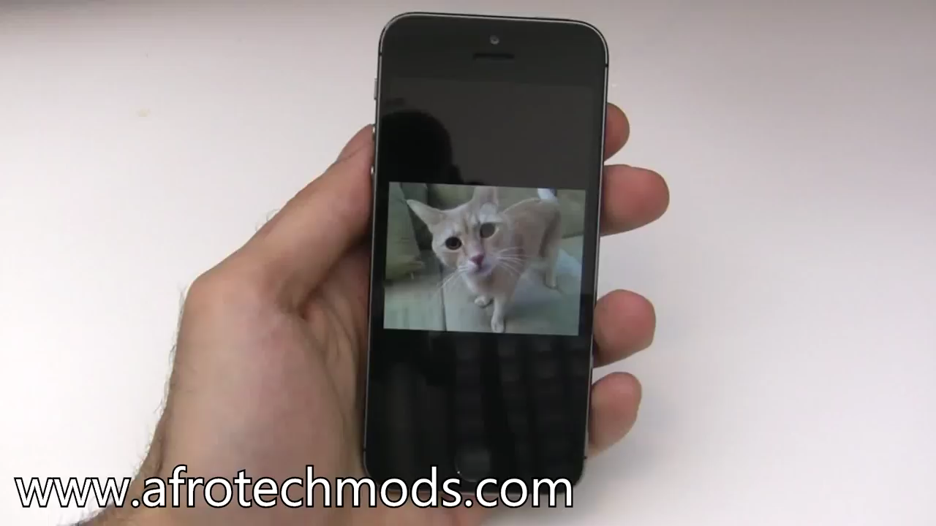

Slide 27
Magnetic Field Sensors
A magnetic field sensor detects changes in a magnetic field.
It measures the strength and direction of a magnetic field and responds to any changes in the magnetic field
If your phone has a compass then your phone has a magnetic field sensor called a magnetometer
If your phone has a smart cover, then this also uses magnetic field sensors
Also used in airport scanners.

Slide 28


Slide 29
Gas sensor
These sense gas levels
If you have one in your home, it usually senses Carbon Monoxide – which can kill you ☺ if you breathe in too much
Also used in nuclear plants to detect gases that might start a fire.
Also used in water plants, to see how much toxic gas is created when they try to clean the water.

Slide 31
Pressure sensor
Okay….Cambridge says pressure sensor only measures the pressure of a liquid or gas, usually in a pipe.
But there are also pressure sensors that measure weight
Cambridge says the way the pressure of a liquid or gas is measured is done by having a material inside a pipe that when the liquid or gas passes though it, it conducts an electrical charge at a certain rate
If that rate changes then the pressure sensor senses it and probably sounds an alarm.

Slide 32
Pressure sensor
Cambridge does not talk about weight being a pressure sensor.
But you can have weight sensors in cars.
When you sit in a car and don’t put on your seatbelt, the car starts to beep
In alarm clocks. You have to stand up on the alarm clock before it turns off

Slide 33
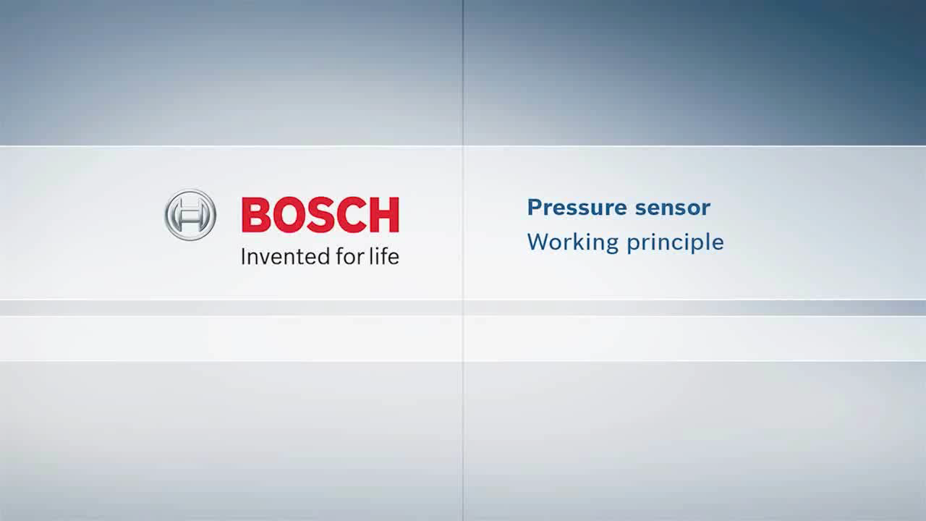

Slide 34
Moisture and Humidity
Moisture measures how wet something is. It measures the something directly
Humidity measures how wet the air around something is and the temperature around it.
Common moisture sensor is when you need to find how wet soil is.
Once you know how wet soil is you can set up an automated system to water the soil.
Automated = make something automatic

Slide 35
Humidity sensor
Also called a hygrometer
Measure water vapour and temperature in the air
High humidity = more bacteria = you die quicker, so you may get a humidity sensor for your house.
Also used in museums and art galleries to make sure the paintings do not get damaged by excess water in the air

Slide 36
pH sensors
pH sensor = Potential of Hydrogen sensor
Measures how acidic or alkaline something is.
14 levels
0-6 = acid
7 = neutral
8-14 = alkaline
Used in water treatment plants to get as close to 7 as possible
Used in aquariums to make sure your fish don’t die (or does die – depends on how evil you are)

Slide 37
Advanced sensors
Some terms:
Transducer = Converts one energy form into another
Sensor = Deice that receives a signal and responds
Actuator = A device that moves another devices

Slide 38
Transducers
Light bulb
Electrical > light
Electric motor (e-bike)
Eclectic > mechanical energy for motion
Microphone
Sound > Electric
Loudspeaker
Electric > Sound

Slide 39
Sensor
Receives and responds
The sensor acts as a transducer because it will read something and then need to convert that into a format a computer can understand. This format is electricity
So a sensor does 2 things:
1: Transduces a signal
2: Quantifies a signal
Quantify = Take your signal and find a way to measure it either analogue or digitally.

Slide 40
Categories of sensors
Thermal
Temperature
Thermostat
Mechanical
Pressure
Altimeter (measures altitude from a fixed point)
Electrical
Ohmmeter to measure resistance
Galvanometer to measure voltage
Chemical
Oxygen sensor
Gas sensor
pH sensor
Optical
Light
Infrared

Slide 41
Monitor vs Control
Most sensors read analogue signals.
They need to quantify this so a computer can understand so it becomes a digital signal
To do this, they use an ADC
ADC = Analogue to Digital converter
Sensors are used to either monitor or control.

Slide 42
Monitor vs Control
Monitor
Sensor sends data to a computer via an ADC
If the value of the data is too high or low then something happens. Maybe an alarm sounds or a display is given. But then you as a Human have to do something.
Control
Sensor sends data to a computer via an ADC
If the value is too high or low then the computer can send signals to devices to turn off/on or to open/close. Usually these devices are connected to actuators. If they are connected to an actuator then a DAC (Digital to Analogue) converter is used.

Slide 43
Examples
Monitor
Patient vital signs in hospital
Burglar alarm system
Pollution levels
Control
Nuclear power station radiation levels
Street lights
Automatic doors

